Slide 1
Multi-Image Based Photon Tracing for Interactive Global Illumination of Dynamic Scenes
Chunhui Yao¹ Bin Wang¹ Bin Chan²
Junhai Yong¹ Jean-Claude Paul^{3,1}
¹ Tsinghua University, China
² The University of Hong Kong, China
³ INRIA, France

Slide 2
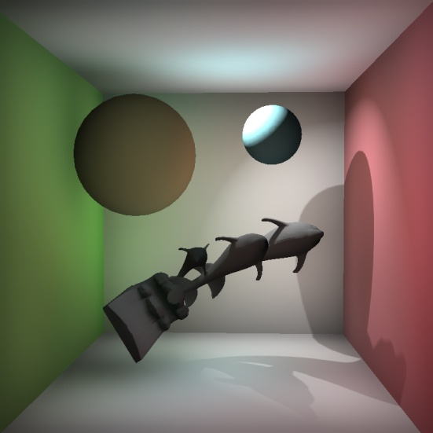
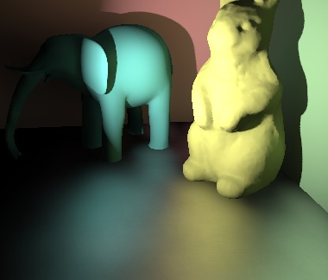
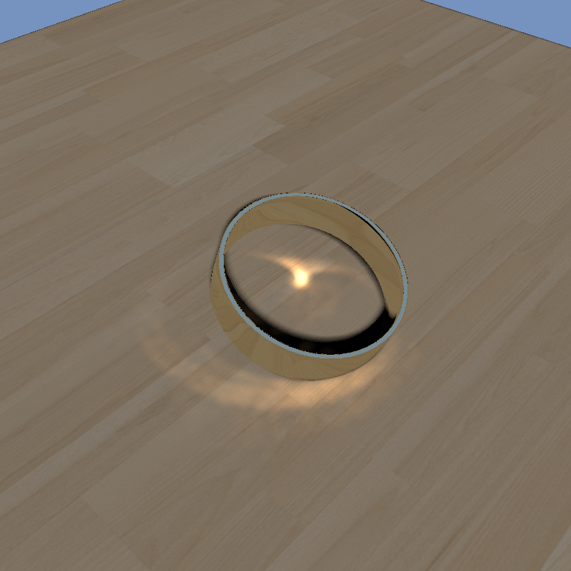
Motivation
A Simple, Practical Technique for
Interactive
Global Illumination
of Dynamic Scenes
Multi-bounces on both low and high frequency surfaces with occlusion
Fast enough to response user’s actions immediately
No pre-computation, everything (camera, light, geometry) completely dynamic
Easy to implement on conventional hardware
specular
glossy
diffuse

Slide 3
Previous Works

Slide 4
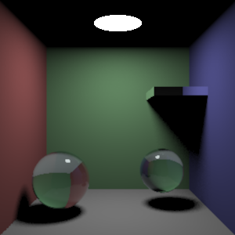
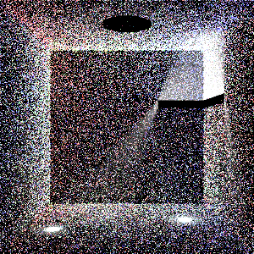
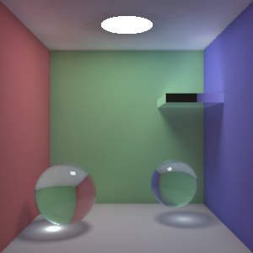
Photon Mapping
Traditional photon mapping
Off-line rendering
Seconds / minutes for rendering
Photon tracing &
Radiance reconstruction
Both expensive!

Slide 5
Image Space Photon Tracing
 |  | Image Space | Object Space
Pros. | Reconstruction | Fast | Slow
 | Implementation | Simple | Complicated
 | Searching | Depend on geometry complexity | Constant time
Cons. | Accuracy | Approximate | Accurate
 | Applicability | Simple | All cases

Slide 6
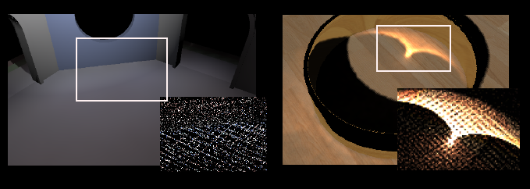
Why Image Space?
Consider the disadvantages
Approximate result
Photon mapping only care about the density of points
Represent geometry by images
Use multiple environment maps
Select centers to cover most surfaces
Our main contribution

Slide 7
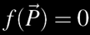
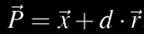
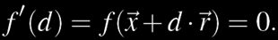
Existing Methods
Image space ray tracing
For specular reflection
Szirmay-Kalos et al. 2005
For caustic photon tracing.
Caustic mapping
Key idea
Store geometry information in depth maps
Implicit equation of the surface
Points along the ray
Solve equation

Slide 8
Problems with Single Image
Problem 1：Required point is not stored in the rendered image
Viewpoint
Ray
B
A

Slide 9
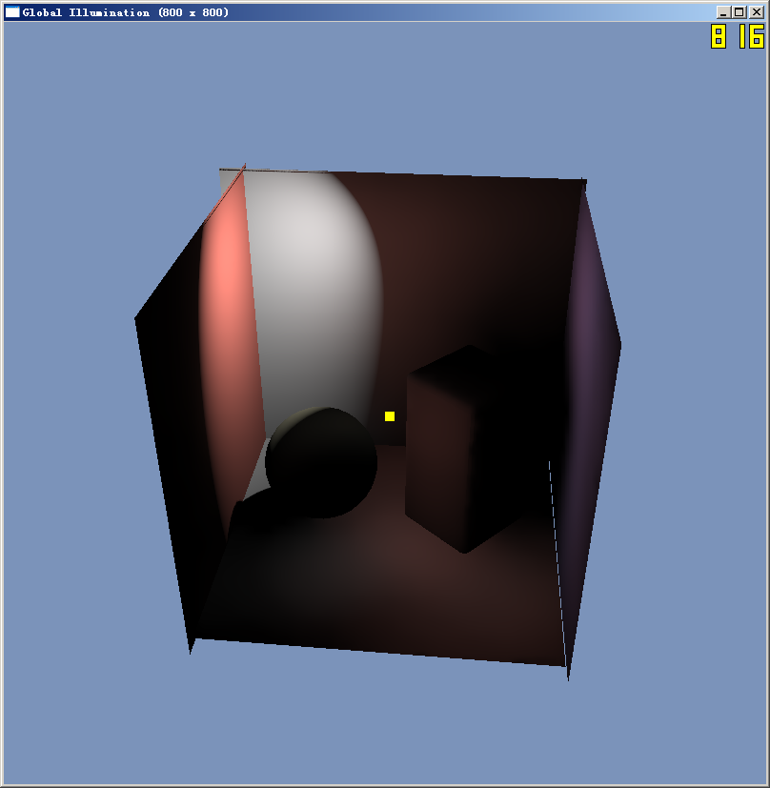
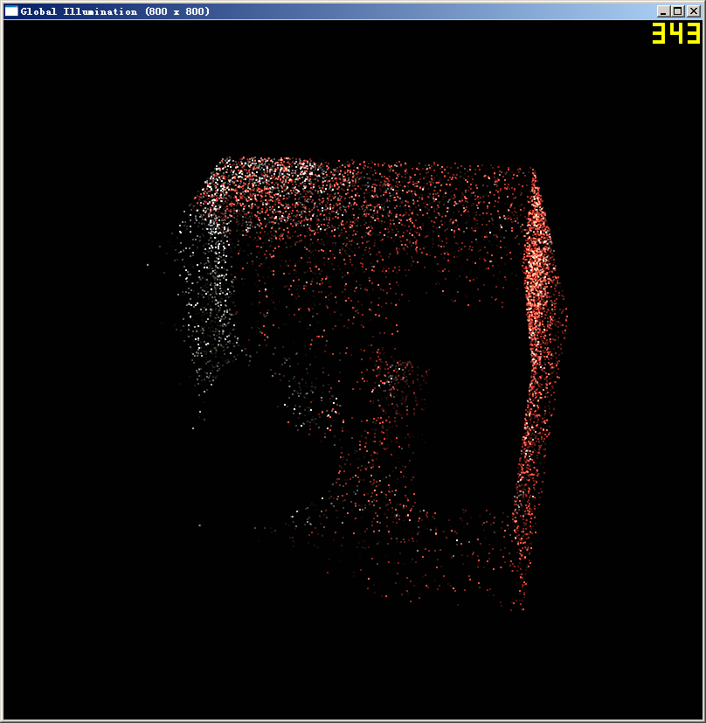
Problems with Single Image
Problem 1：Required point is not stored in the rendered image

Slide 10
Problems with Single Image
Problem 2: obtained result may be not the first intersection along the ray
Viewpoint
Ray
A
B

Slide 11
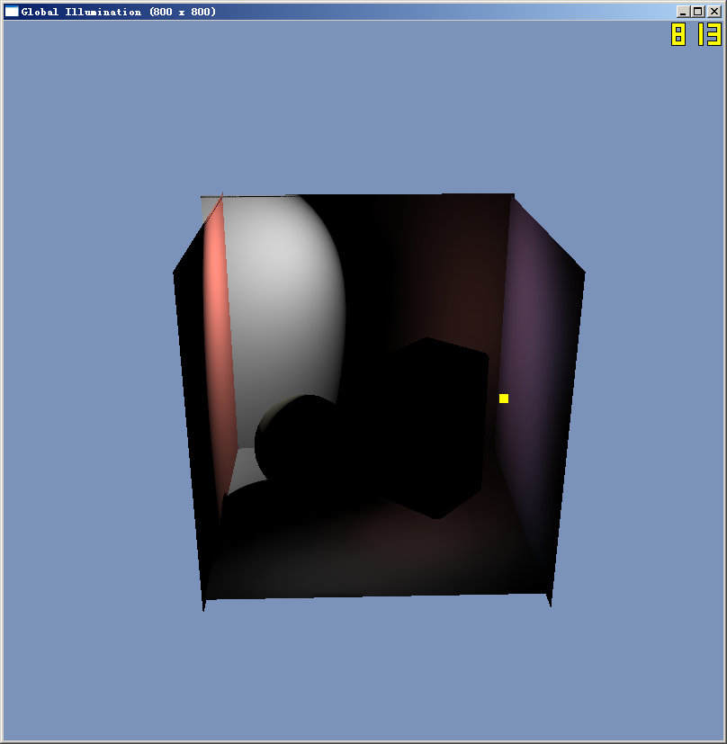
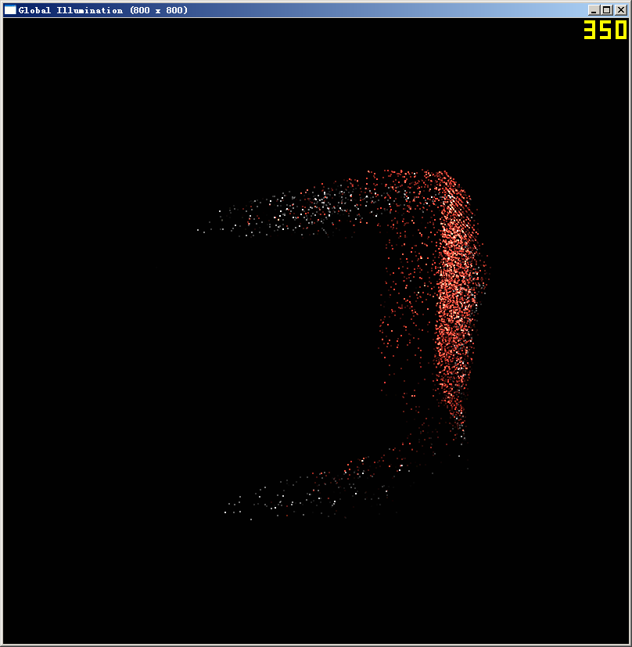
Problems with Single Image
Problem 2: obtained result may be not the first intersection along the ray

Slide 12
Multiple Environment Maps
Single environment map
Add more environment maps
Scene

Slide 13
How to Select Images?
Simplest idea
Choose them randomly
Coverage not guaranteed
Our idea
First sample large number of points randomly
Then choose some for largest coverage
This is a NP-hard problem
Equivalent to set-covering problem
Find smallest k sets covering all elements
Classical NP-hard problem

Slide 14
Heuristic Selection
Selecting k points with greedy algorithm
Mark all points unselected
For all unselected points, compute its new coverage area
The area covered by the point but not covered by any selected point
Mark the point v with maximum new coverage area selected
Repeat for k times

Slide 15
New Coverage Area

Slide 16
Updating Selection
Initialization
Heuristic algorithm
Update with scene changed
Find an unused point with largest new coverage, add to selection set
Among the k+1 points, remove the point with the smallest coverage

Slide 17
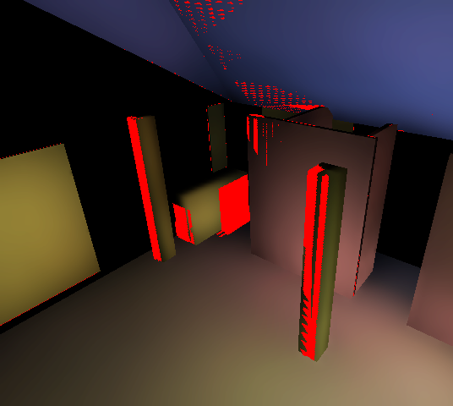
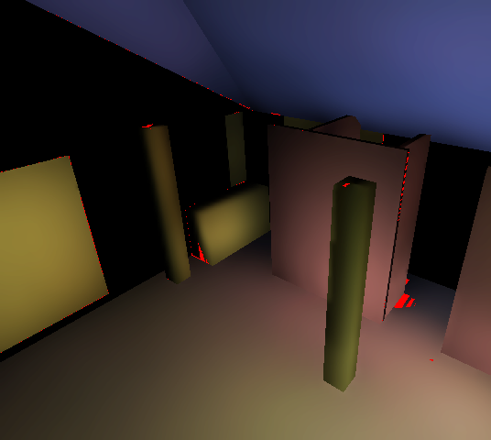
Coverage
Red pixels indicate uncovered area
8 random maps
8 selected from 27 random maps

Slide 18
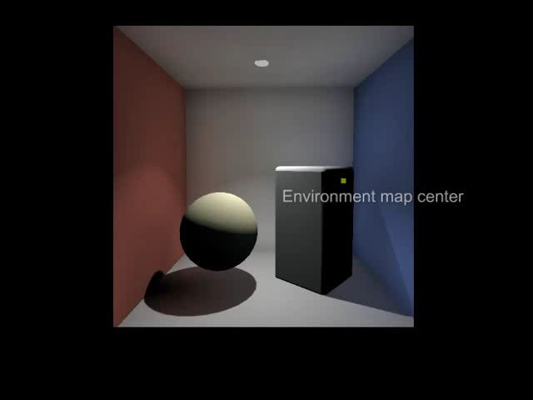

Slide 19
Finding Intersection
Test with each environment map
Several results
Four possible types
Not in the ray
Infinity
A
Ray
No intersection
B
D
C
The correct intersection
Not first intersection

Slide 20
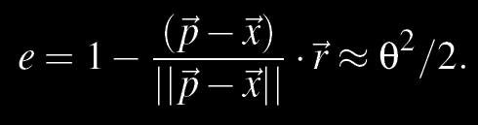
Finding Intersection
Reject A immediately
Reject B by angle bias
Find the nearest point to the ray origin
Implemented as depth testing of rasterization
Infinity
A
Ray
B
D
C

Slide 21
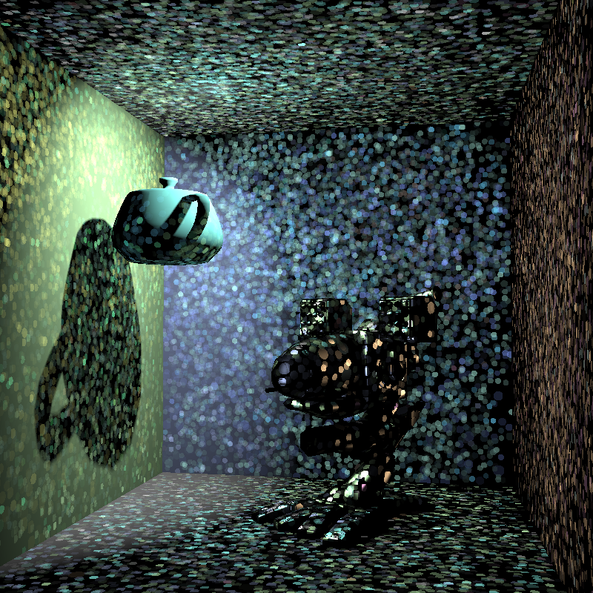
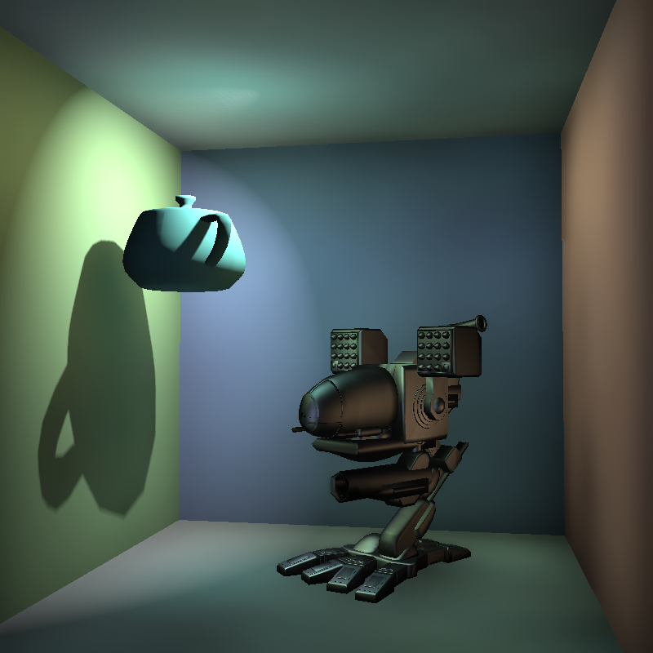
Rendering
Scatter illumination onto screen
Photon splatting

Slide 22
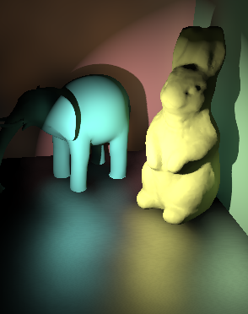
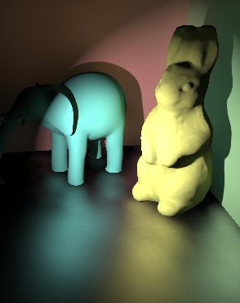
Variable splat sizes
Control by probability for variable splat sizes
Fixed splat sizes
Variable splat sizes

Slide 23
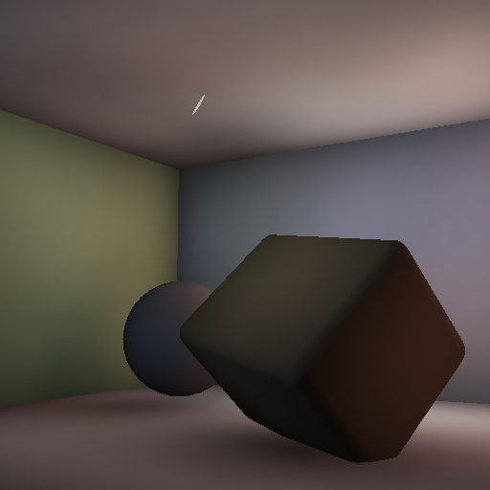

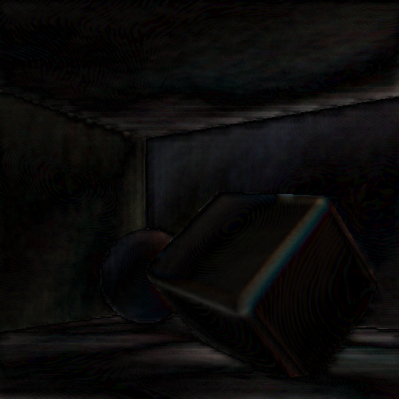
Multi-Level Upsampling
Reduce fill-rate
No upsampling 3FPS
3-level upsampling 24 FPS
8 x Error

Slide 24
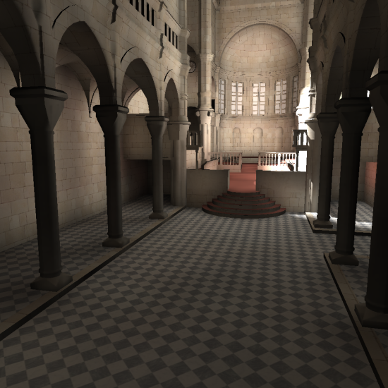
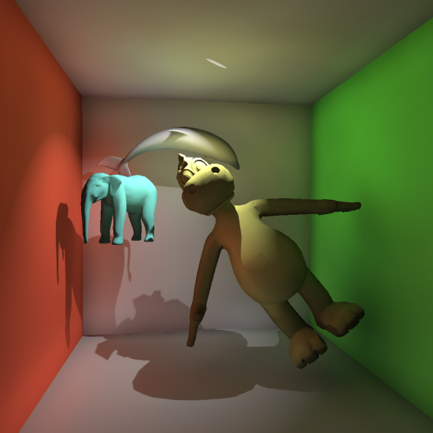
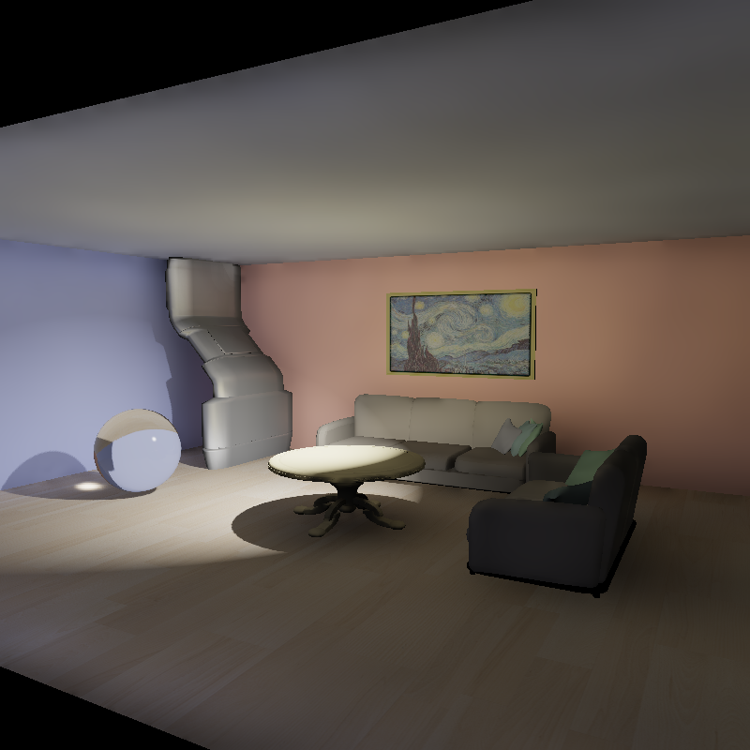
Result

Slide 25
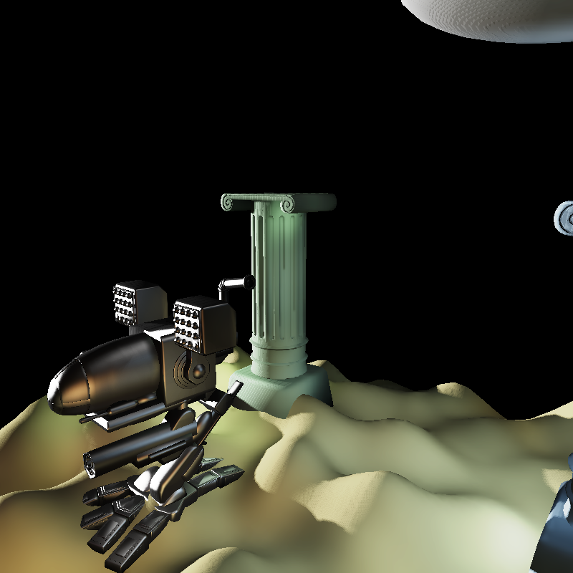
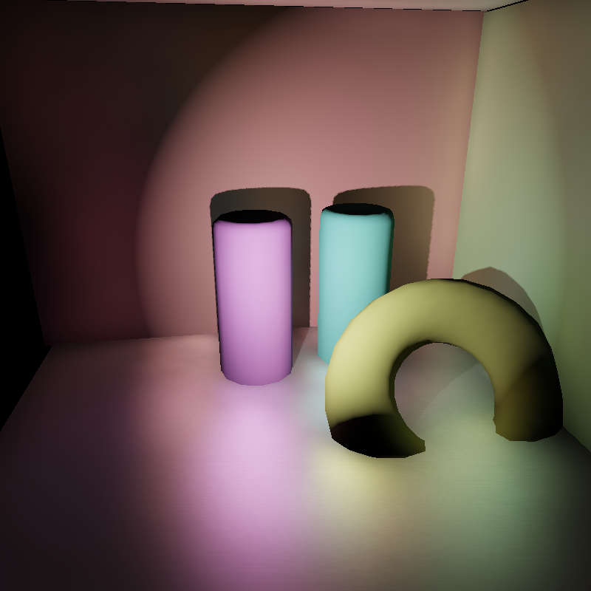
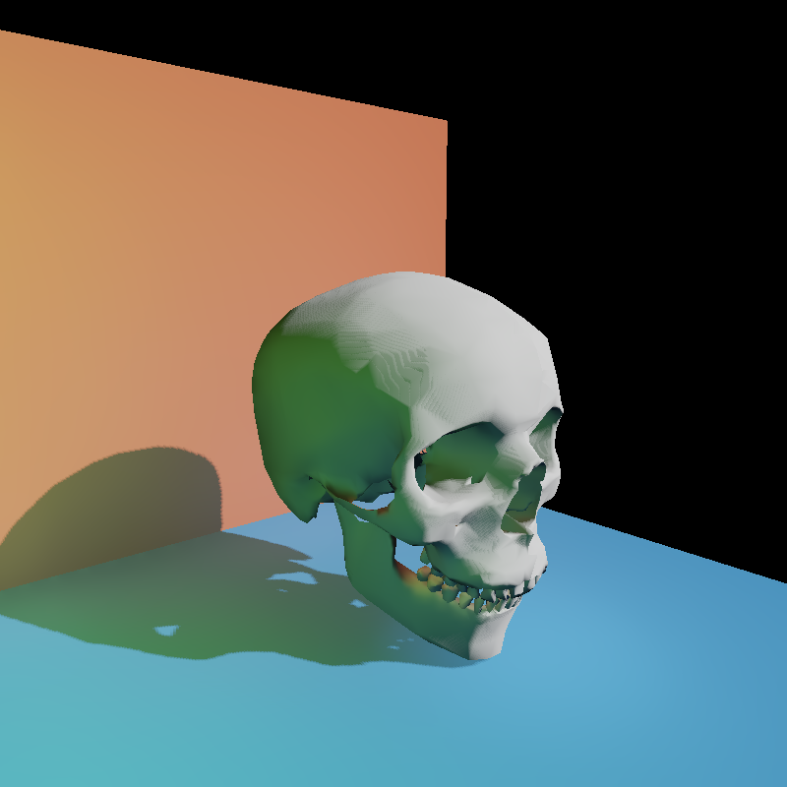
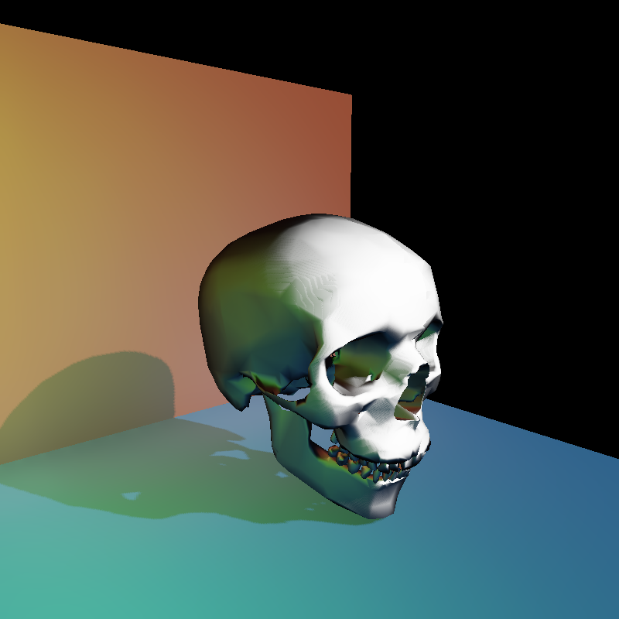
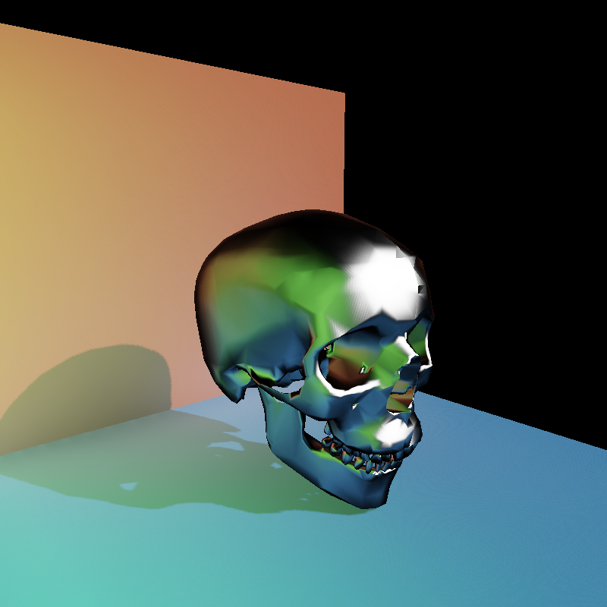
Result: Glossy
Diffuse
Phong, n=30
Phong, n=100

Slide 26
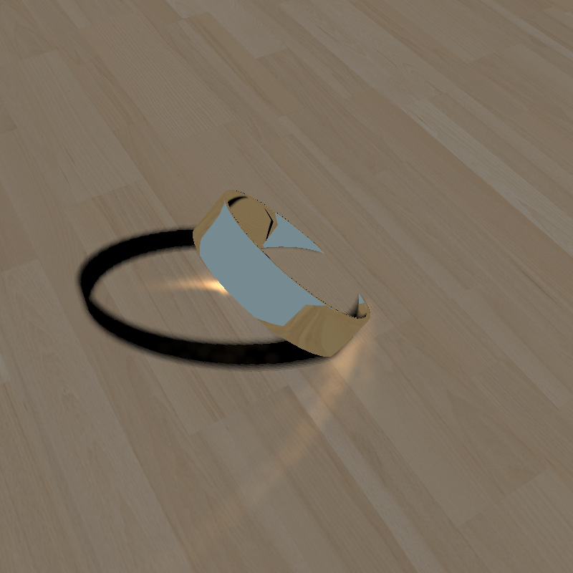
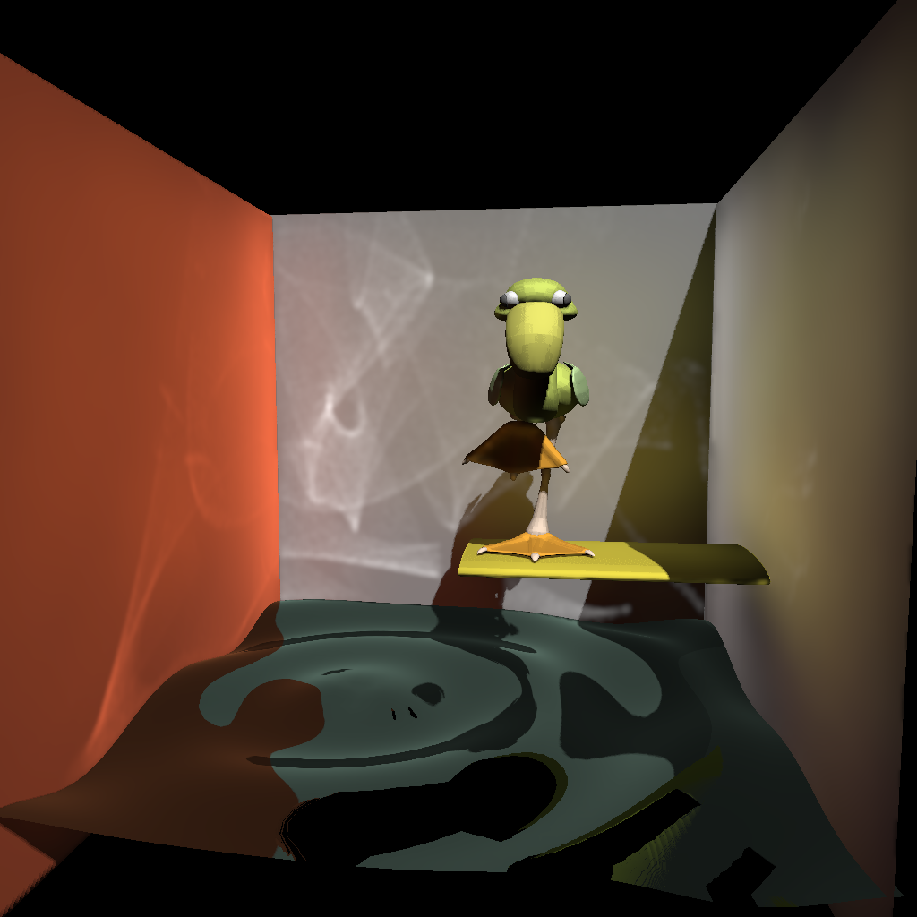
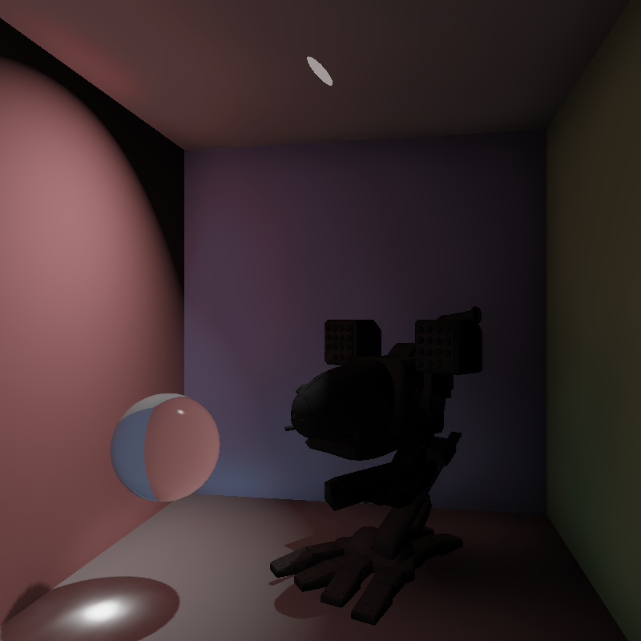
Result: Caustics

Slide 27
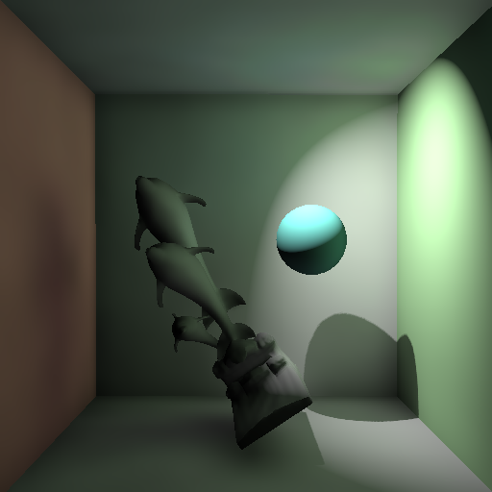
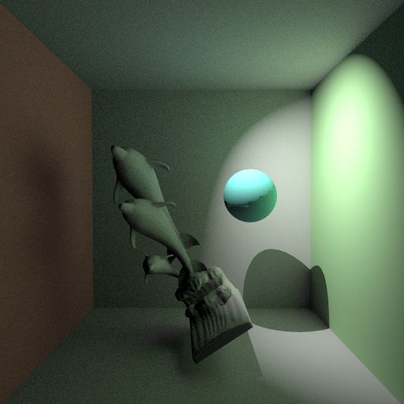
Ground Truth Comparison
Ours: 21 FPS
Path tracing
Indirect shadows

Slide 28
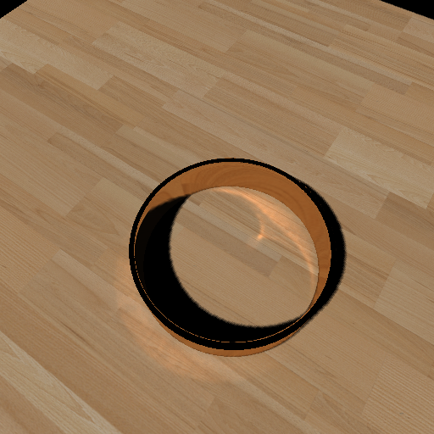
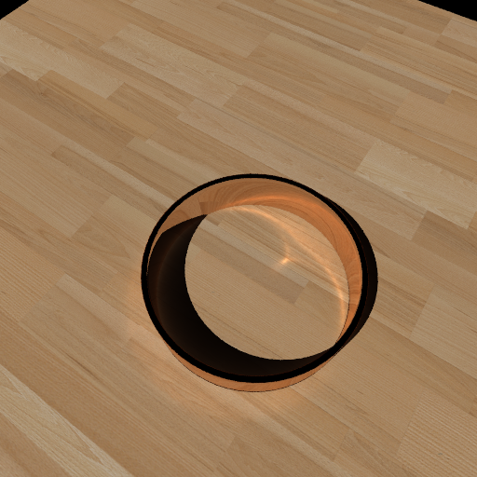
Ground Truth Comparison
Ours: 38 FPS
Photon Mapping
Caustics

Slide 29
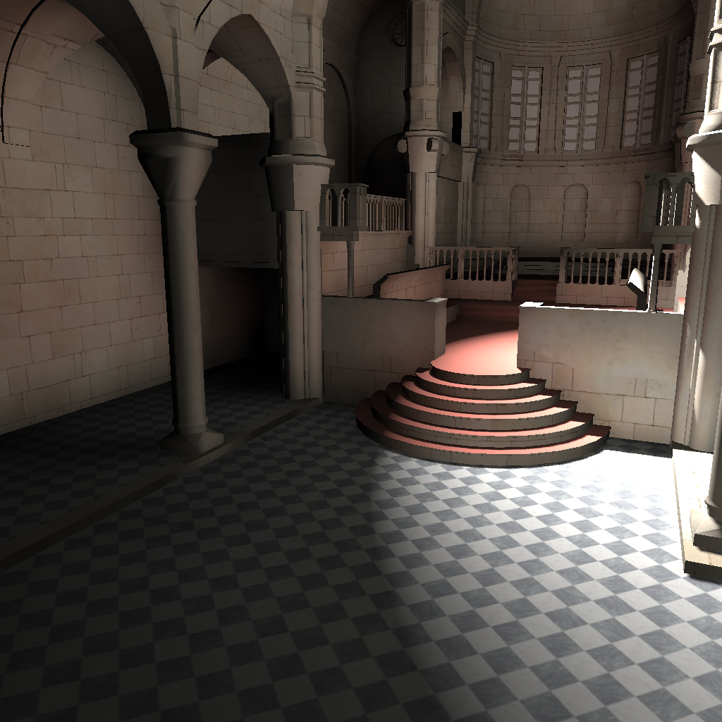
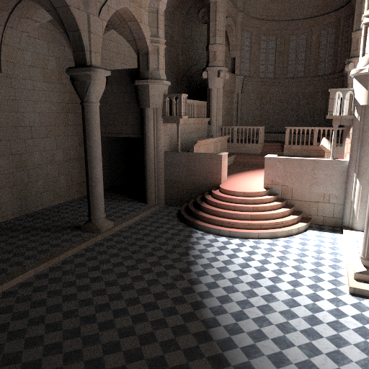
Ground Truth Comparison
Ours: 13 FPS
Path tracing

Slide 30
Performance
On NVIDIA Geforce 260 GTX @ 1024 X 1024
Scene | Triangles | Global Photons | Caustic Photons | FPS
Box1 | 15K | 376K | 0 | 11.4
Water | 21K | 91K | 89K | 12.8
Room1 | 84K | 403K | 2.9K | 5.4
Sibenik | 79K | 739K | 0 | 5.5
Box2 | 58K | 464K | 0 | 9.2
Room2 | 101K | 368K | 0 | 7.5
Ring | 2.1K | 0 | 164K | 28.2
Under Water | 54K | 536K | 822K | 6.3
High quality first

Slide 31
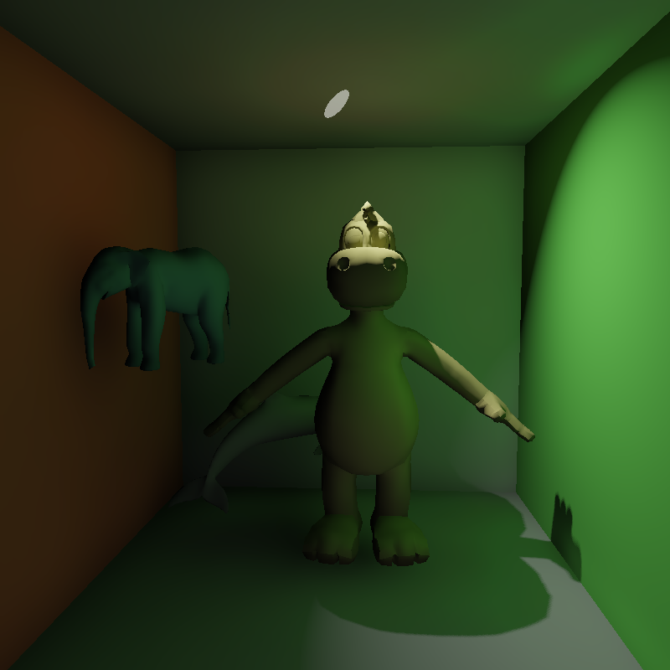
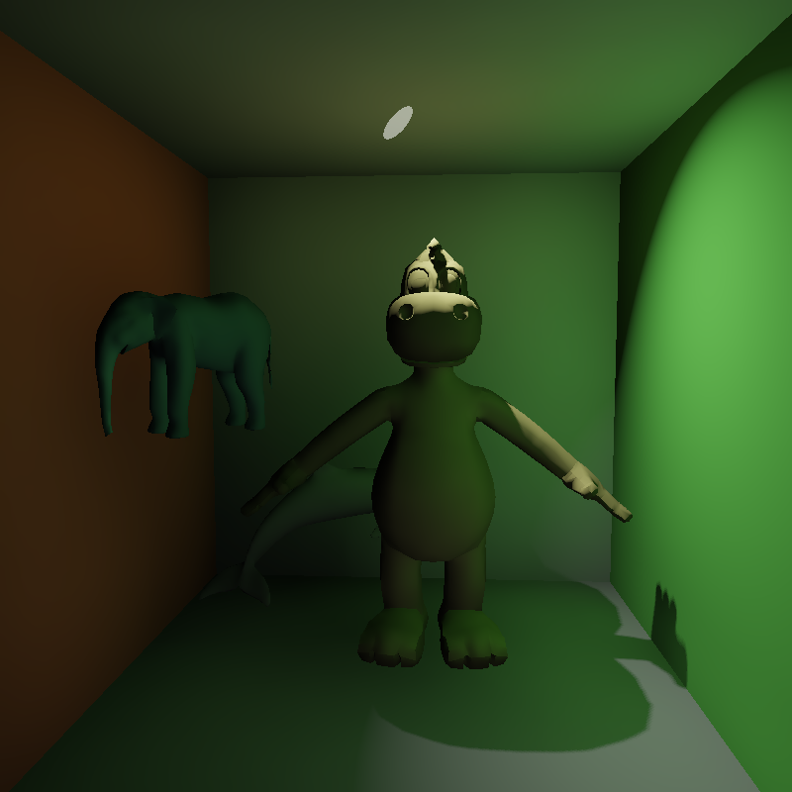
Performance/Quality
800 X 800
776k photons @ 11 FPS
78k photons @ 40 FPS
Similar to [McGuire 09]
Indirect shadow
Boundary bias

Slide 32
Limitation：Bias
Blurry shadow
Light leaking
Dark area
Ours: 13 FPS
Path tracing

Slide 33
Limitation: Reflection
Ours: 38 FPS
Photon Mapping

Slide 34
Video

Slide 35
Thank you for your attention

